Slide 1
Jenis-jenis Operator Penugasan (Assignment) Bahasa C++

Slide 2
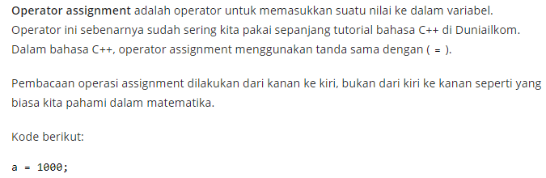
Pengertian Operator Assignment / Penugasan

Slide 3
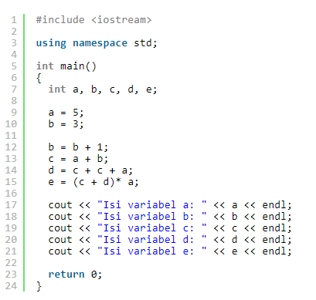
Contoh Kode Program Operator Assignment Bahasa C++

Slide 4
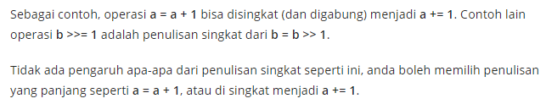
Operator Assignment Gabungan Bahasa C++

Slide 5
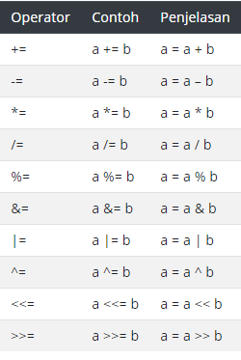

Slide 6
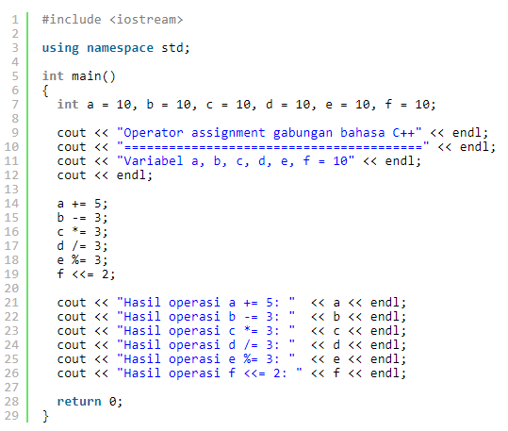
Contoh Kode Program Operator Assignment Gabungan Bahasa C++

